Slide 1
Spark GraphX
Big Data Lab
22th October 2025

Slide 2
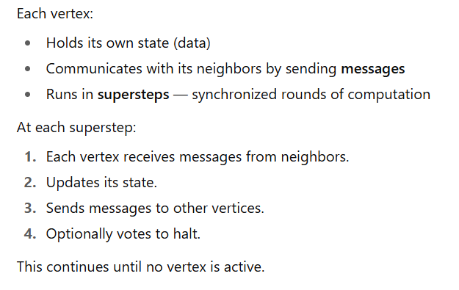
What is Pregel?
Pregel is a distributed graph processing model developed by Google (published in 2010).
It’s based on the vertex-centric idea — “Think like a vertex.”
Algorithm:

Slide 3
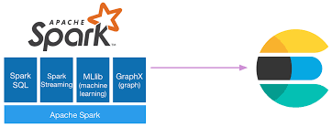
What is Spark GraphX ?
Part of Apache Spark for graph processing and graph-parallel computation
Allows to represent data as graphs (vertices + edges)
Supports both graph algorithms and data-parallel operations
Built on top of Spark’s RDD (Resilient Distributed Dataset)

Slide 4
Basic Commands
Basic graph creation
Step | Code | Description
Import packages | import org.apache.spark.graphx._ import org.apache.spark.rdd.RDD | Required for GraphX and RDDs
Define vertices | val vertices: RDD[(VertexId, String)] = sc.parallelize(Seq( (1L, "Alice"), (2L, "Bob"), (3L, "Charlie"), (4L, "David") )) | Each vertex has an ID and a label
Define edges | val edges: RDD[Edge[String]] = sc.parallelize(Seq( Edge(1L, 2L, "follows"), Edge(4L, 1L, "connects") )) | Each edge connects two nodes with a relationship
Create graph | val graph = Graph(vertices, edges) | Builds a directed graph

Slide 5
Frequent High Level Function
Function | Example | Description
map | rdd.map(x => x * 2) | Applies a function to each element to produce a new RDD of transformed elements.
filter | rdd.filter(x => x > 5) | Keeps only the elements that satisfy a condition.
distinct | rdd.distinct() | Removes duplicate elements from the RDD.
union | rdd1.union(rdd2) | Combines two RDDs of the same type into one.
intersection | rdd1.intersection(rdd2) | Returns only elements that exist in both RDDs.
subtract | rdd1.subtract(rdd2) | Removes elements in the second RDD from the first.
groupBy | rdd.groupBy(x => x % 2) | Groups elements according to a function or rule.
groupByKey | rdd.groupByKey() | Groups values with the same key (for key-value RDDs).
sortByKey | rdd.sortByKey(ascending = true) | Sorts key–value pairs by their key.
cache | rdd.cache() | Persists the RDD in memory for reuse in future actions.

Slide 6
Subgraph extraction
Operation | Syntax / Example | Description
filterVertices | graph.subgraph(vpred = (id, attr) => attr.startsWith("A")) | Filter vertices only.
filterEdges | graph.subgraph(epred = triplet => triplet.attr == "follows") | Filter edges only.
joinVertices | graph.joinVertices(newVertexRDD){ (id, oldAttr, newAttr) => updatedAttr } | Updates vertex attributes by joining with another VertexRDD. Useful for adding computed values like degrees or ranks.
vertices.join | graph.vertices.join(vertexRDD) | Joins two VertexRDDs to combine attributes. Returns (vertexId, (attr1, attr2)).
edges.map | graph.edges.map(e => (e.srcId, e.dstId)) | Extract source-destination info from edges; often used before joins or subgraph creation.
triplets | graph.triplets | Accesses source vertex, edge, and destination vertex for more complex filtering or join operations.

Slide 7
Graph Information
Operation | Code | Description
View vertices | graph.vertices.collect.foreach(println) | Shows all vertex IDs and labels
View edges | graph.edges.collect.foreach(println) | Lists all edges (source, destination, label)
Human-readable view | graph.triplets.collect.foreach(t => println(s"${t.srcAttr} --${t.attr}--> ${t.dstAttr}")) | Prints relations like “Alice --follows--> Bob”
In-degree | graph.inDegrees.collect.foreach(println) | Incoming edges count for each vertex
Out-degree | graph.outDegrees.collect.foreach(println) | Outgoing edges count for each vertex
Total degree | graph.degrees.collect.foreach(println) | Total degree (in + out) for each vertex
Outgoing neighbors | graph.triplets.map(t => (t.srcAttr, t.dstAttr)).groupByKey().collect() | Lists who each node points to
Incoming neighbors | graph.triplets.map(t => (t.dstAttr, t.srcAttr)).groupByKey().collect() | Lists who points to each node

Slide 8
Reverse graph
Operation | Code | Description
Reverse edges | val reversedGraph = graph.reverse | Reverses the direction of all edges
View reversed graph | reversedGraph.triplets.collect.foreach(t => println(s"${t.srcAttr} --${t.attr}--> ${t.dstAttr}")) | Displays the reversed edge directions
Save and Load Graph(text)
Operation | Code | Description
Save graph | graph.vertices.saveAsObjectFile("vertices_obj") graph.edges.saveAsObjectFile("edges_obj") | Reverses the direction of all edges
Load graph | val vertices = sc.objectFile[(Long, String)]("vertices_obj") val edges = sc.objectFile[Edge[String]]("edges_obj") | Displays the reversed edge directions
Miscellaneous:
Use :help to get reference list of basic commands
Use :type for any variable to know its datatype
Use .collect() only when you need final calculation
Use .cache() for a variable if you are going to use it often

Slide 9
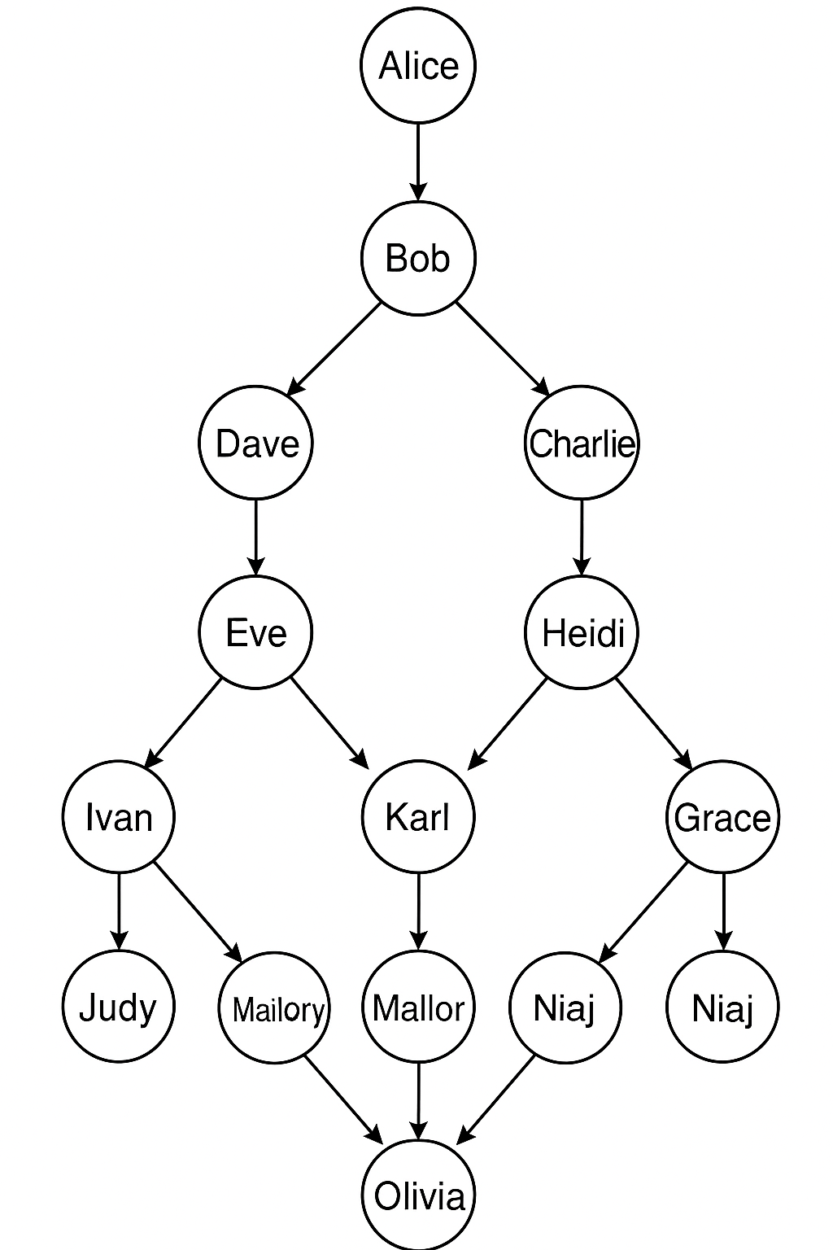
Lab Task 1
Make the Graph Given below then find the following(add your name in box):
(a)In-Degree for each vertex
(b)Out-Degree for each vertex
(c)Print all Triplets
(d)Randomly choose any 3 vertex (exclude yours) and find its neighbour(incoming & outgoing)

Slide 10
Lab Task 2
Make the Graph using Triplets Given below (add atleast 5 more triplets on your own use same set of vertex and edge attributes):
Build the graph
Obtain a subgraph with only “friend” edge attribute
In graph and its subgraph find how many vertex are there degree less than or equal to 2
Check if subgraph is connected graph
List of Triplets
("Alice", "Bob", "friend")
("Alice", "Charlie", "friend")
("Bob", "David", "follow")
("Charlie", “Ave", "friend")
("David", "Frank", "friend")
(“Ave", "Grace", "follow")
("Frank", "Hannah", "friend")
("Grace", "Ivy", "friend")
("Hannah", "Jack", "follow")
("Ivy", "Alice", "follow")
("Jack", "Bob", "friend")
("Charlie", "Frank", "follow")
("David", "Grace", "friend")

